Slide 1
System Design Characteristics: Clean Code Principles, CI/CD Pipelines
System Design(SD)(22CS024)
Bachelor of Engineering- Computer Science & Engineering
Department of Computer Science & Engineering
Chitkara University Institute of Engineering and Technology, Chitkara University, Punjab, India

Slide 2
Clean Code Principles
Clean code is more than just correct code — it's readable, maintainable, and elegant.
Prioritizes clarity so that others (and your future self) can understand it easily.
Avoids unnecessary complexity; focuses on doing one thing well.
Uses consistent formatting, meaningful naming, and modular design.
Clean code is structured to accommodate changes with minimal risk.
Aligns with industry conventions like SOLID principles, DRY, and KISS.
Easier for teams to work on, debug, and extend collaboratively.
Well-written code often reduces the need for excessive comments.
Demonstrates a developer’s discipline, thought process, and respect for the next coder.

Slide 3
Why Is Clean Code Important?
Enhanced Maintainability: Clean code is inherently easier to maintain and update, reducing the time and resources needed for future modifications.
Improved Readability: Clean code is easy for new developers to understand and contribute to a project without a steep learning curve.
Increased Efficiency: Well-organized codebases are less prone to bugs and issues, facilitating a smoother development process and quicker troubleshooting.
Better Collaboration: Clean code principles encourage practices that make collaborative work more seamless, allowing teams to work more effectively together.

Slide 4
Principles
Meaningful Names: Use descriptive, specific names for variables, functions, and classes that clearly convey their purpose.
Keep It Simple, Stupid (KISS): Avoid unnecessary complexity. Aim for simplicity in your solutions.
Don’t Repeat Yourself (DRY): Minimize duplication in your codebase to ensure that every piece of knowledge has a single, unambiguous representation.
Single Responsibility Principle (SRP): Each module, class, or function should have one reason to change, encapsulating a single responsibility.
Readability Over Cleverness: Code should be straightforward and easy to read rather than overly clever or complex.

Slide 5
How to Write Clean Code
Writing clean code is an iterative process that involves constant refinement and adherence to best practices. Following points must be kept in mind:
Refactor Regularly: Review and refine your code to improve its structure and readability.
Follow Style Guidelines: Adhere to your language’s style guidelines and conventions for formatting and structuring your code.
Code Reviews: Participate in code reviews to receive feedback and learn from others’ approaches to problem-solving.

Slide 6
Clean Code Best Practices
To further embed clean code principles in development process, consider these best practices:
Write Unit Tests: Ensure your code is testable and covered by unit tests to maintain functionality and prevent regressions.
Document Thoughtfully: While clean code should be self-explanatory, judicious use of comments can clarify complex logic or decisions.
Use Version Control Wisely: Leverage version control systems to manage changes and collaborate more effectively with others.

Slide 7
Tips to Write Cleaner Code
Enhancing the cleanliness of your code is a continuous journey. Here are some tips to guide you along the way:
Start Small: Focus on improving one aspect of your code at a time.
Learn from the Masters: Study code from experienced developers and open-source projects to see clean code principles.
Practice, Practice, Practice: Like any skill, writing clean code gets easier with practice. Challenge yourself with new problems and projects.

Slide 8
CI/CD Pipeline
CI/CD is a DevOps strategy that automates software development and deployment.
Integrates and automates every stage—from coding to testing to deployment.
Continuous Integration (CI):
Developers frequently merge code into a shared repository.
Automated tests run on each change to ensure quality and detect issues early.
Continuous Delivery (CD):
Automates application release processes.
Ensures software can be deployed to production at any time with minimal manual intervention.
Teams work on a single codebase with automated pipelines for consistency.

Slide 9
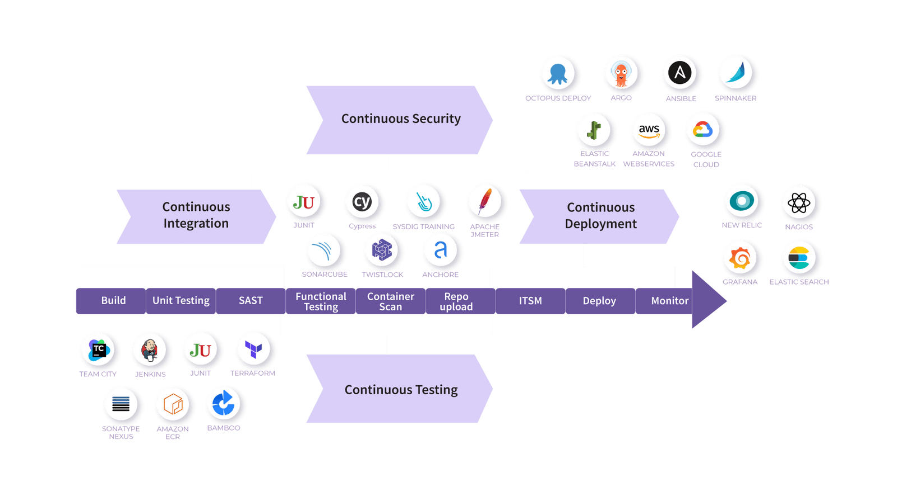
CI/CD Pipeline

Slide 10
Continuous Integration
CI automates the build and testing process whenever developers commit code to version control.
Shared Repository: All developers merge changes—big or small—into a central branch regularly (main/trunk).
Automated Pipeline:
Triggered with every commit.
Builds the latest code, runs tests, and validates integrity.

Slide 11
Benefits of Continuous Integration
Smaller and Easier Code Changes: ‍With every code change being pushed to version control immediately, the CI/CD pipeline has to deal with smaller code changes and integrations at a time.
Easier Debugging ‍A CI-based pipeline facilitates fault isolation AKA the practice of formulating systems in which errors lead to limited negative consequences.
Faster Product Releases A CI-powered pipeline is a continuously moving system in which failures are detected and debugged faster.
Lighter Backlog As explained above, CI enables quicker bug identification and debugging, all within the early testing stages of code changes and integration.
Increased Transparency and Accountability ‍Frequent code commits lead to immediate and frequent feedback from the automated system as well as the team.

Slide 12
Continuous Deployment
Continuous Deployment is the next step after Continuous Delivery—automatically releases code
to production.
Fully Automated Release:
No manual approvals needed.
Code is deployed directly once it passes all pipeline checks.
Test-Driven Automation:
Deployment depends on a series of pre-defined, automated tests.
Ensures only stable, tested code reaches production.
Zero Human Intervention:
Eliminates delays from manual gatekeeping.
Increases release speed and reliability.

Slide 13
Benefits of Continuous Deployment
Rapid delivery of new features and fixes.
Reduced time-to-market.
Consistent and repeatable deployments.
Immediate user feedback from live environments.
Best Fit For:
Teams with mature testing practices.
Products requiring frequent updates or continuous innovation.

Slide 14
Continuous Delivery vs Continuous Deployment
Aspect | Continuous Delivery | Continuous Deployment
Automation Level | Code is built, tested, and made ready for production | Code is automatically released to production
Approval Required | Manual approval (by Dev, PM, or Team Lead) is required | No manual approval needed; fully automated
Deployment Trigger | Release is manually triggered after validation | Deployment is triggered automatically post-validation
Use Case | Suitable when control and oversight are priorities | Suitable when speed and rapid feedback are essential
Tooling & Maturity | Needs moderate automation and checks | Requires mature CI/CD pipeline with robust testing and rollback
Risk Management | Easier to manage risks via staged rollouts | Requires strong rollback & monitoring strategies

Slide 15
Pipeline Flow:
Code Commit – Developer pushes code to the repository.
Build – Code is compiled and packaged automatically.
Integration – Merged into shared branch, resolving conflicts.
Automated Testing – Unit, integration, and UI tests run.
Deployment – Code is deployed to staging or production.
Monitoring – Performance and errors are continuously tracked.

Slide 16
CI/CD Tools
Configuration Management - Ansible, Puppet, Chef
Code Management - GitHub, GitLab, BitBucket
Build - Jenkins, Bamboo, TeamCity
Testing - Selenium, JUnit, SonarQube
Deployment - Argo, Spinnaker, Octopus Deploy

Slide 17
Thank you

